Slide 1
Demo:
Automating deployment of multi-style integrations
Slides and screen shots

Slide 2
1. Simple deployment of an isolated integration
Image Repository
Template Integration Container Image
Container
Platform
Git
Replica set
Integration artefact
Integration artefact
Integration artefact
Integration artefact
Integration artefact
Operator
Custom
Resource
Definition
Develop
Build
Deploy
Operate

Slide 3
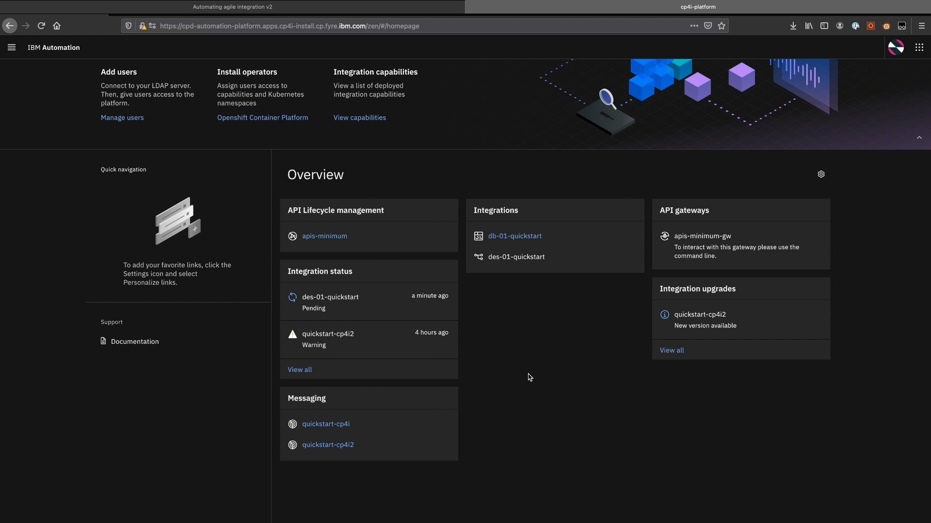

Slide 5
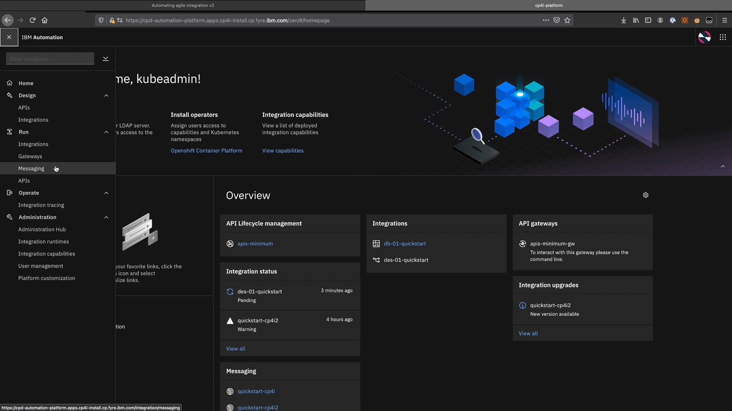

Slide 6
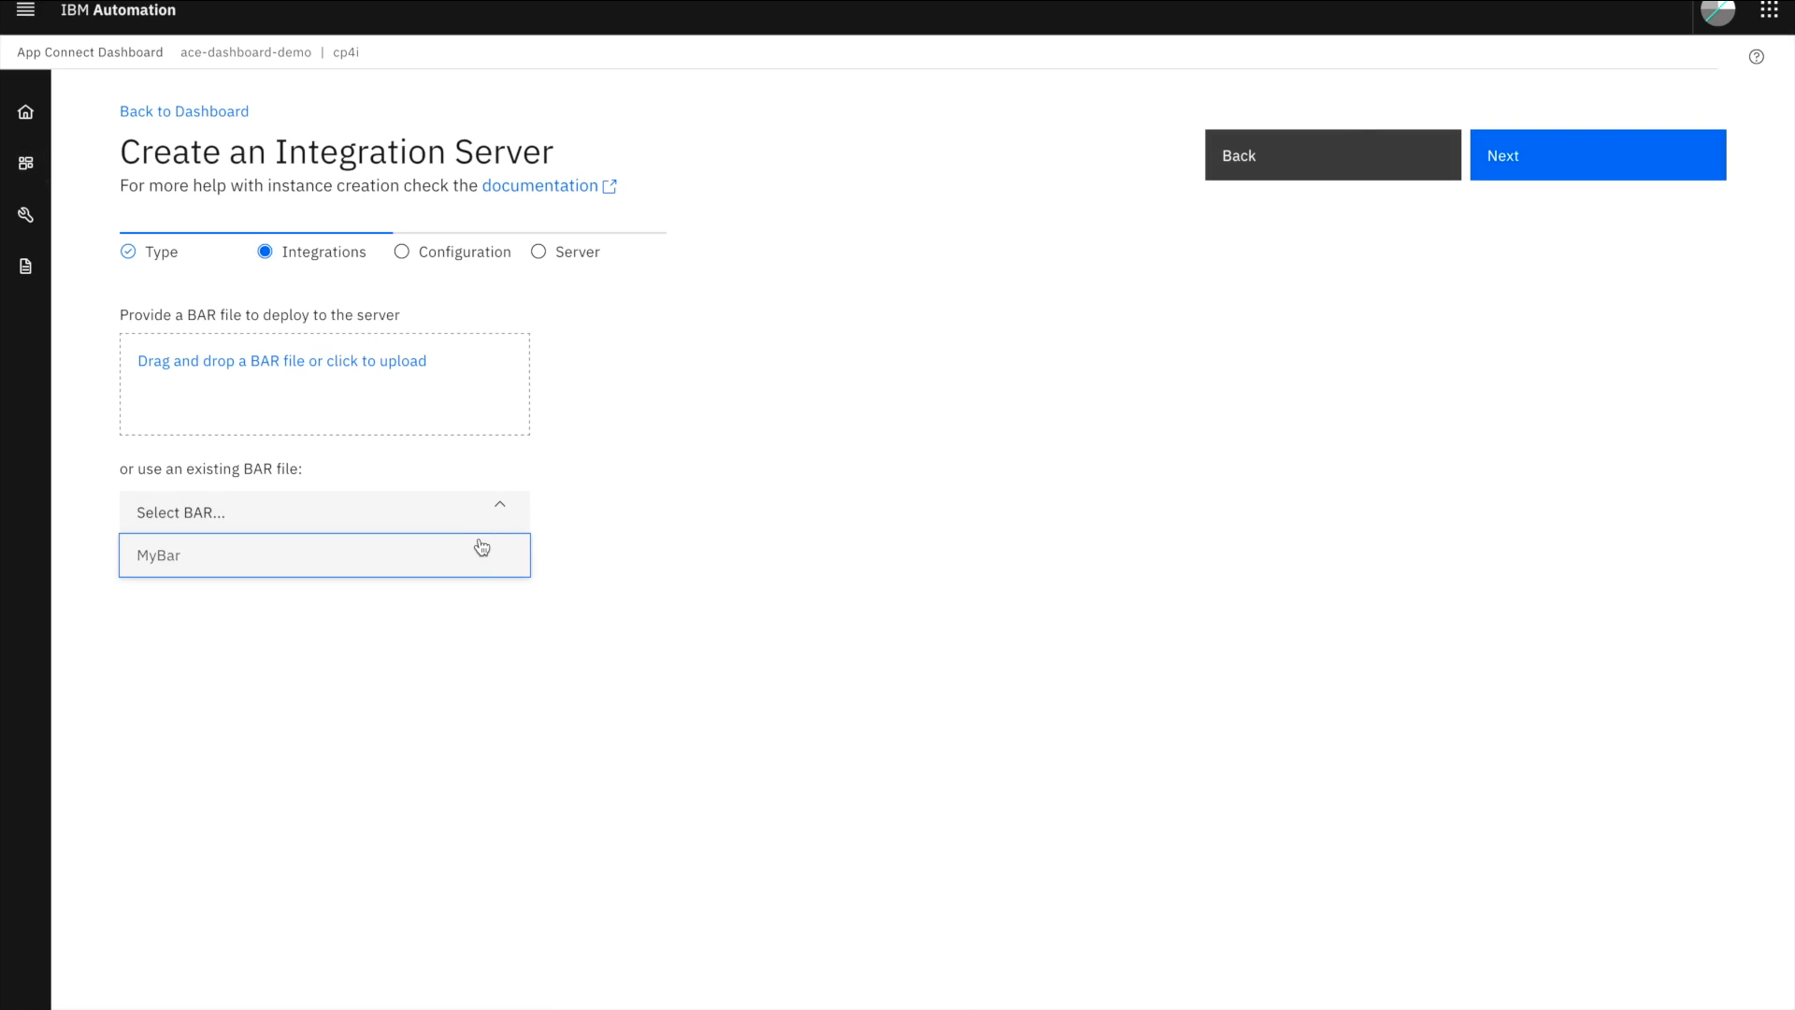

Slide 7
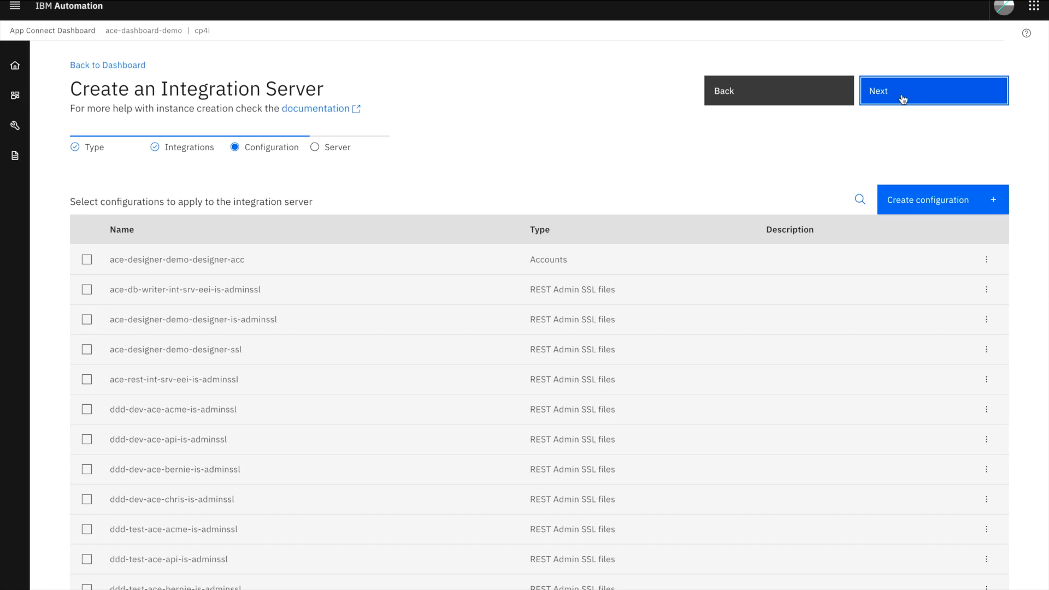

Slide 9
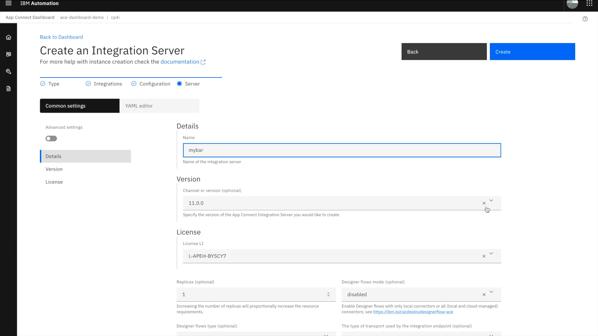

Slide 10
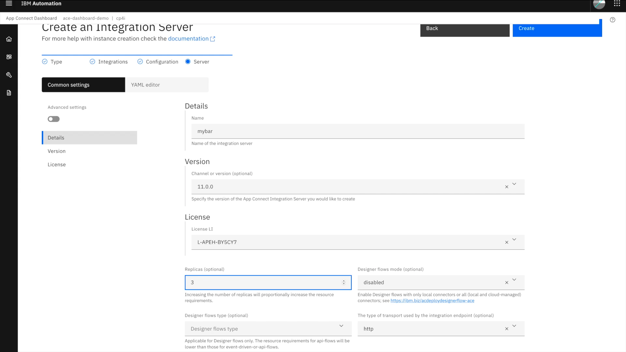

Slide 11
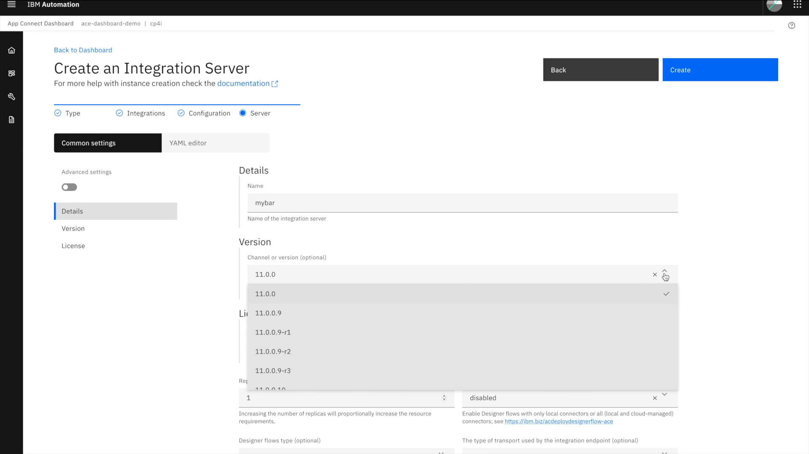

Slide 12
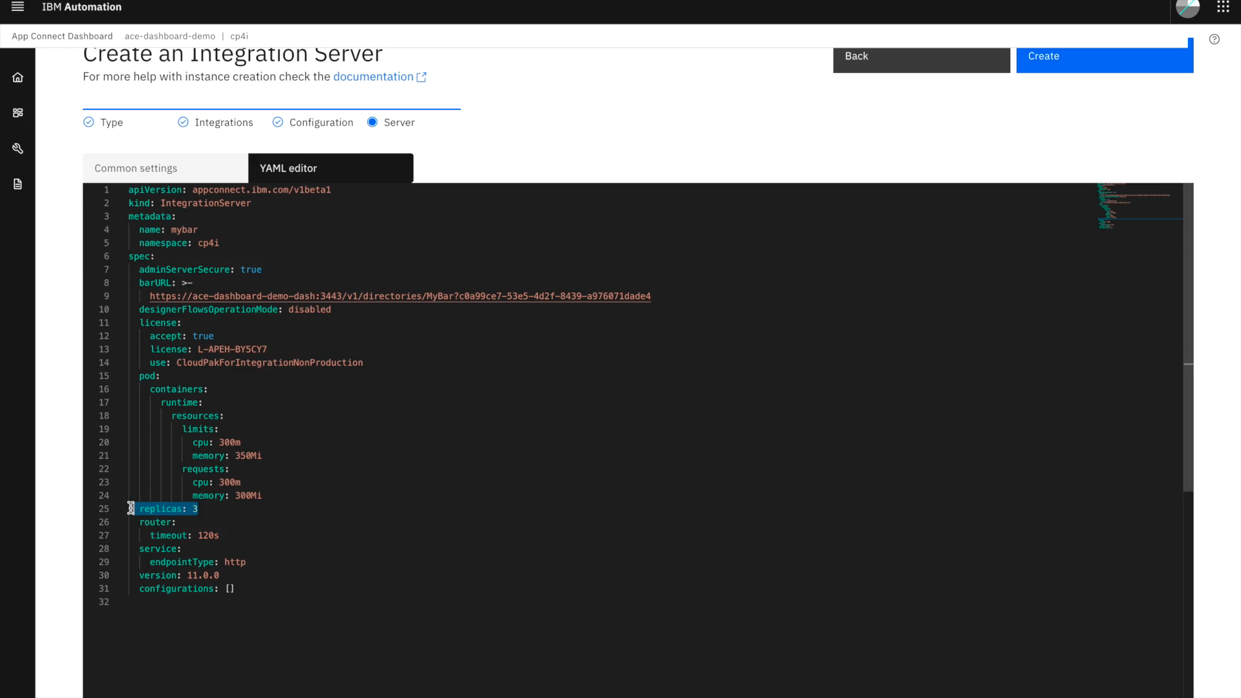

Slide 13
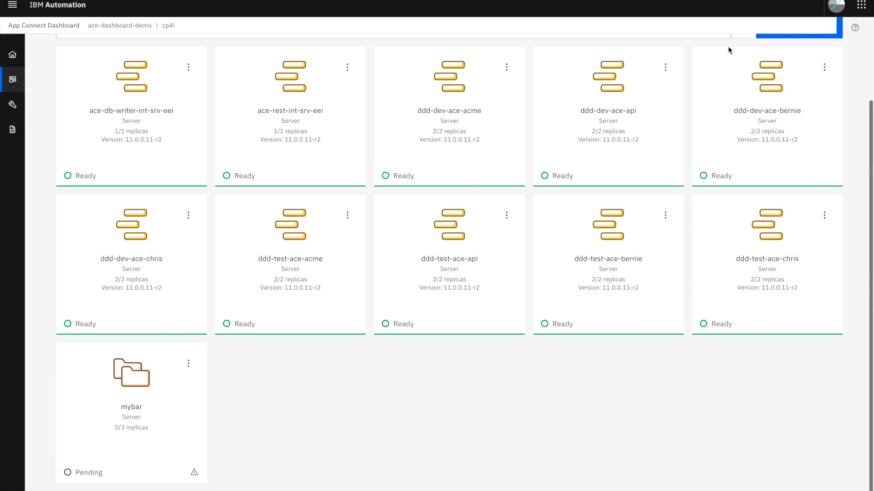

Slide 14
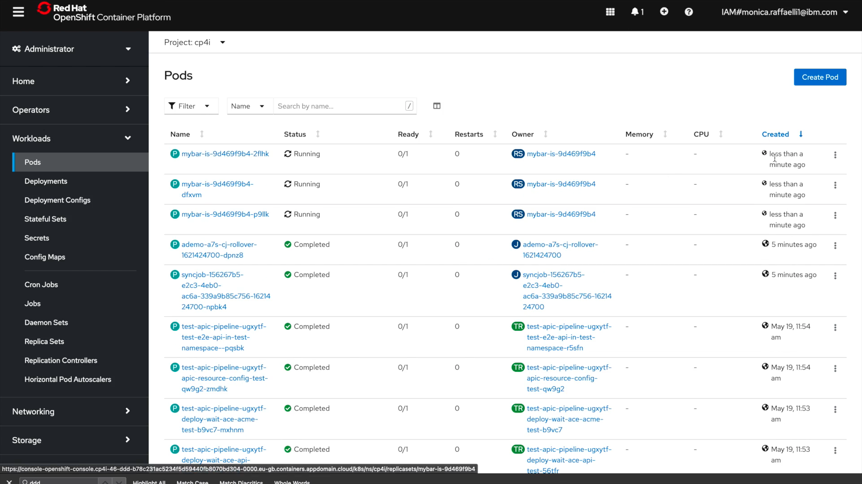

Slide 15

Multi-style integration example – Car repair quote aggregation
An insurance broker wants to automate aggregation of quotations from multiple different companies.
They plan to monetize this by making it available as an API to partners to build into their apps and websites.
They want to be able to amend, deploy, and scale the integrations individually or together.
It must request the quotations in parallel to ensure a rapid overall response.
They need to be able to perform end to end tracing for diagnostics.
API Management
Container
Platform
Integration:
Insurance quote aggregator
Message Queues
Integration: Get ACME’s quote
Integration: Get Bernie’s quote
Integration: Get Chris’s quote
ACME Auto Accidents
Bernie’s Bashed Bumpers
Chris’s
Crumpled Cars

Slide 16
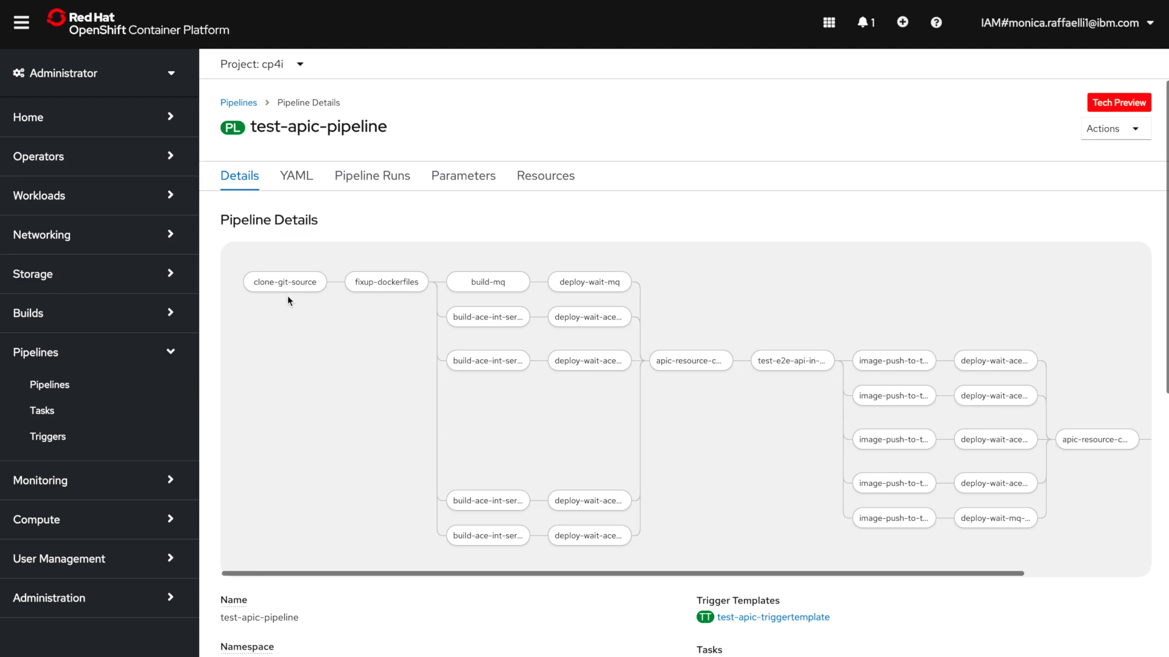

Slide 17
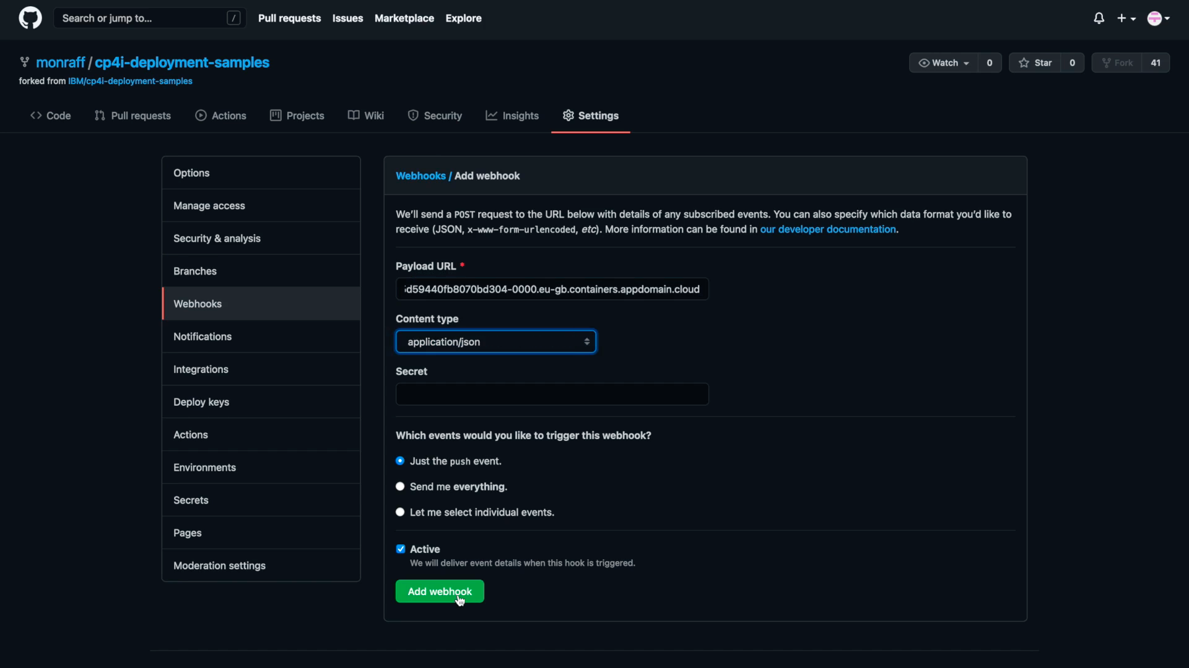

Slide 18
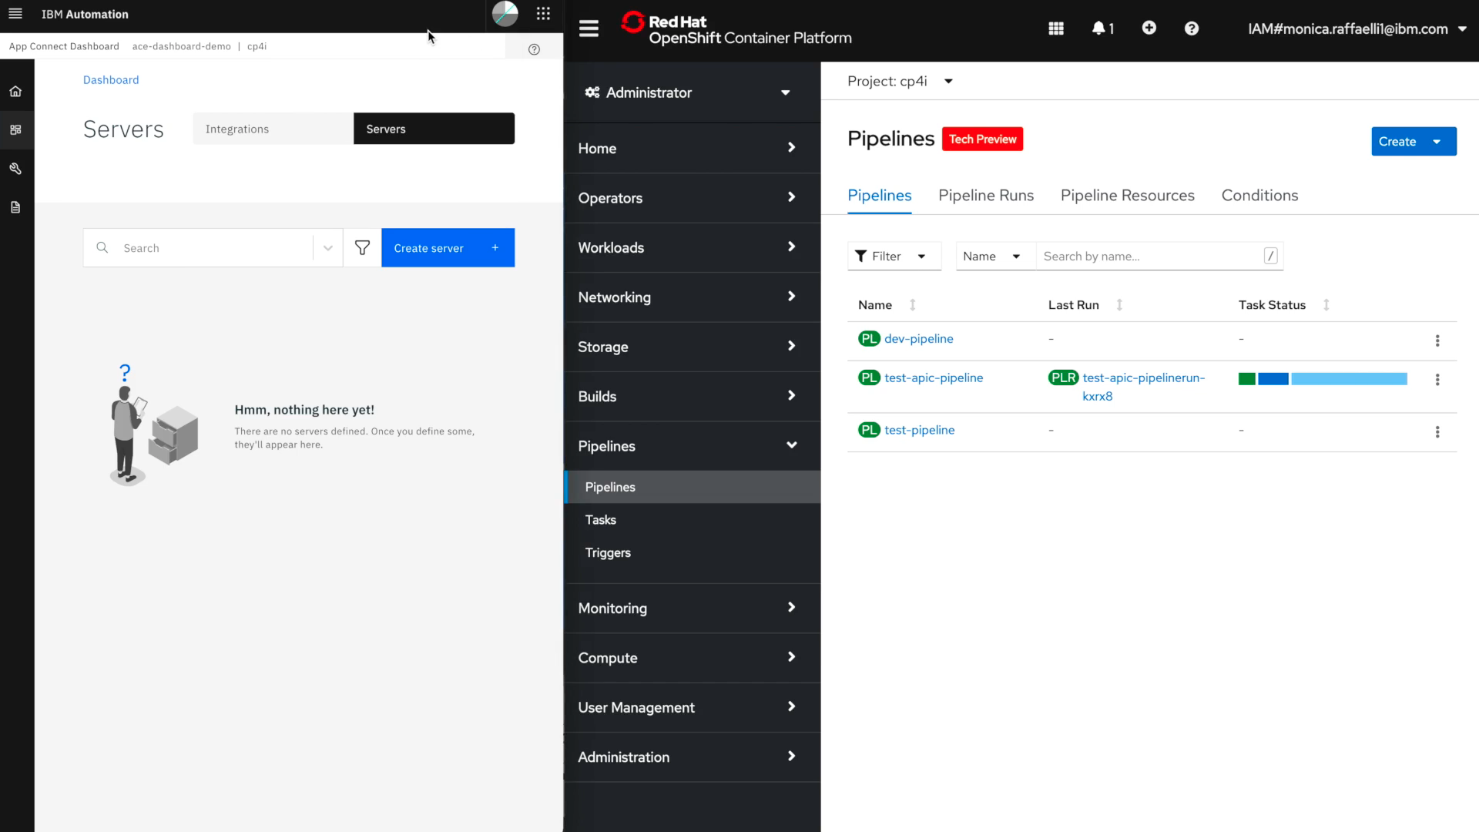

Slide 19
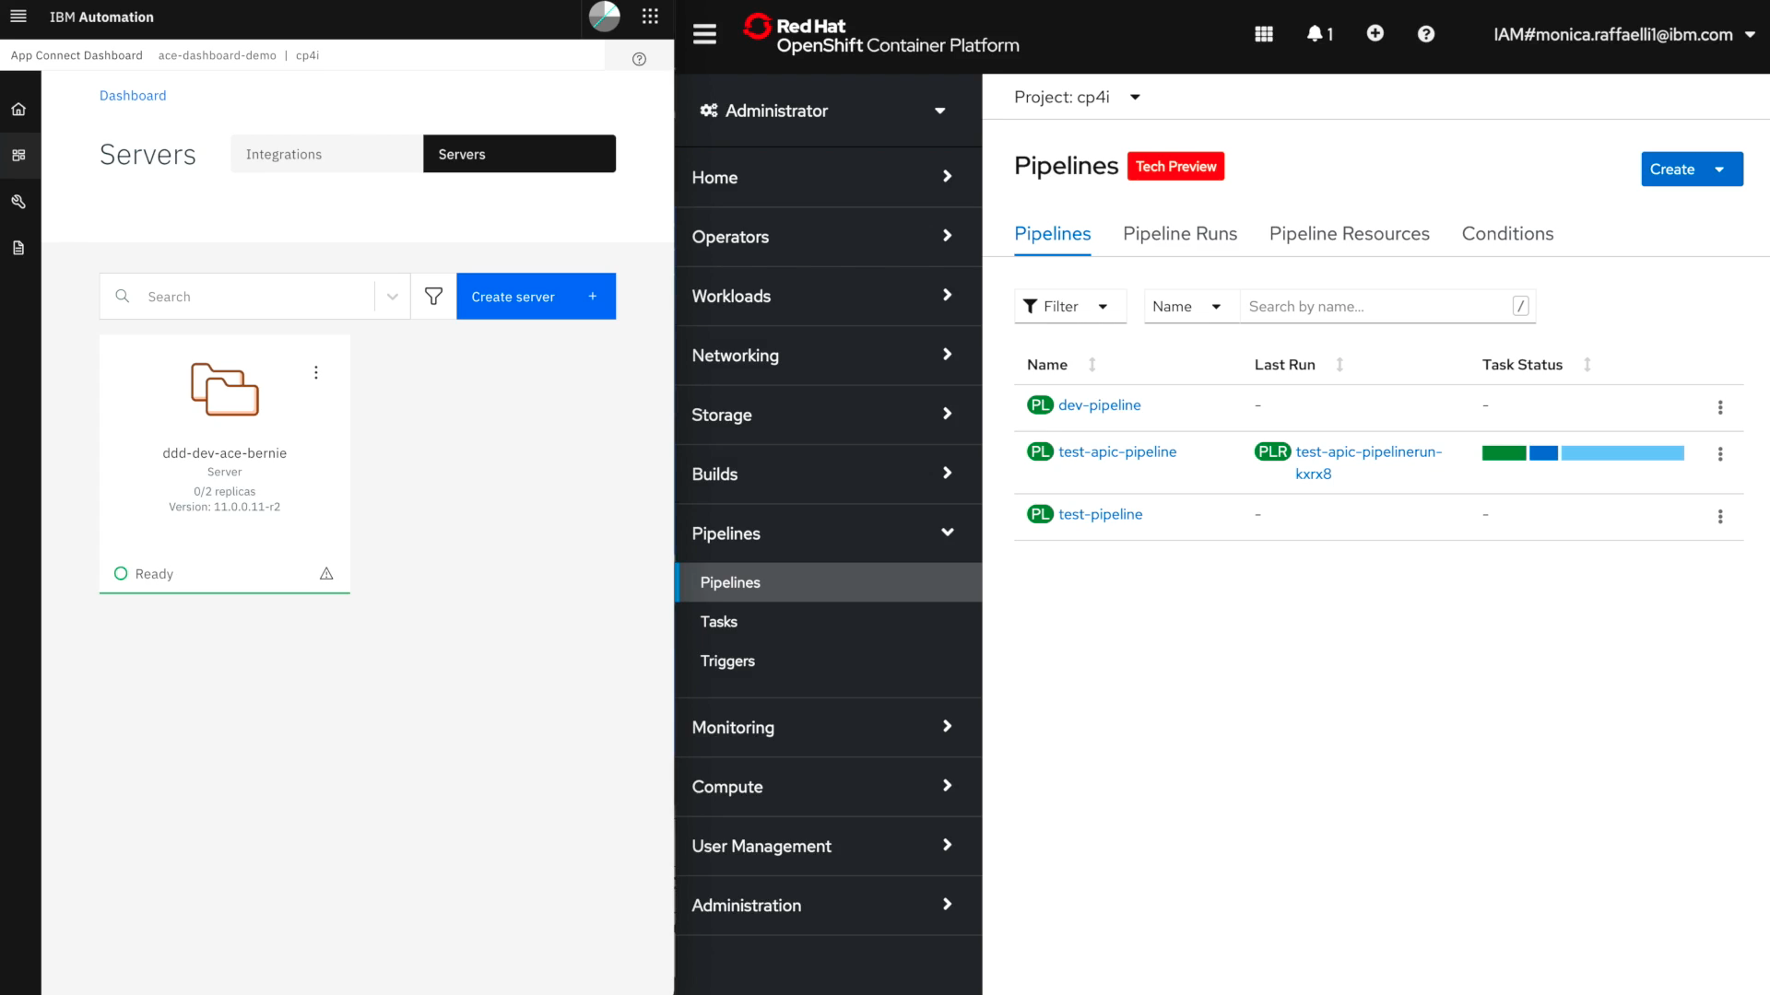

Slide 20
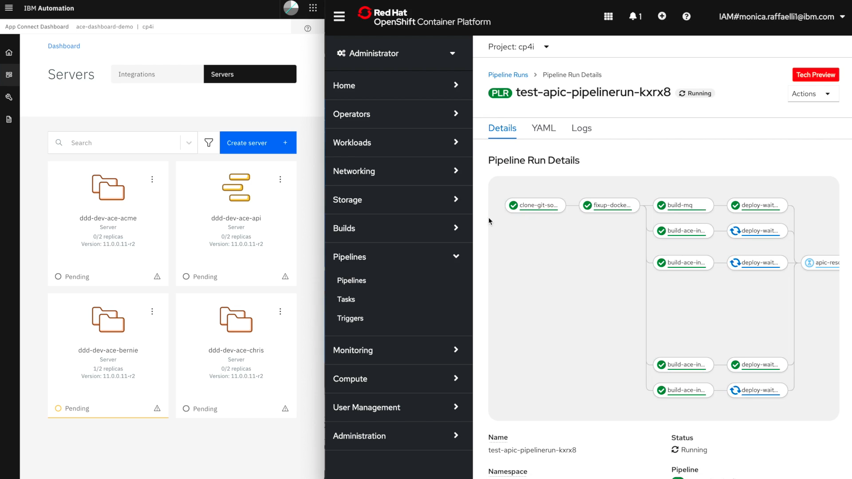

Slide 21
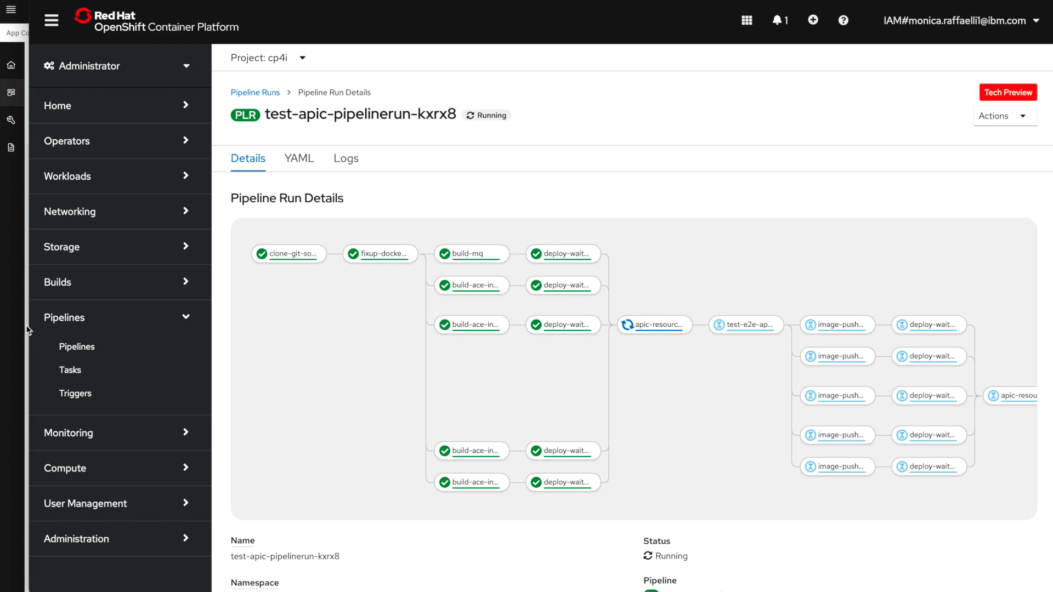

Slide 22
Automation of lifecycle and operations
Git
API Gateway
API Gateway
Container
Platform
API Portal
API Portal
OAS
API
Manager
i
i
Operator
i
i
i
i
CRD
CRD
q
q
Operator
q
q
Development
automation
Deployment automation
Operational
automation
Build
Deploy
Operate
Develop
Build
automation
Integration
runtime image
Messaging
runtime image
Code assist
Flow assembly
Graphical mapping
Intelligent connectors
Pattern templates
RPA interfaces
Pipeline(s)
Git clone
Dependencies
Validate
Package
Build image
Test
Clean up
Trigger deploy?
Operator
Create routes for access
Provision storage
Service mesh policy
Deploy credentials
Wiring to dependencies
Rollout policy
Upgrade management
Multi-part solution deploy?
Operator
HA/auto recovery
Auto scaling
Log collation and interpretation
Alerts
i
Integration
code
q
Queue manager
definition
OAS
Open API
Specification
CRD
Custom resource definition
Infrastructure as code
Validated form entry
Guardrails
http://ibm.biz/agile-integration-cloud-native
Notes:
Lets build up the picture of this pipeline for changes, and see where the automation fits in.
We’ll begin with the build phase.
CP4I, out of the box, provides a simplistic way to for you to provide an integration (bar file) and deploy it into the container environment, which is excellent for rapid prototyping and getting a feel for the container environment. However, we recognize that you will likely have a more complex build process needs that are specific to your enterprise so you will want to develop a pipeline of your own.
Today you will likely have a build script of some sort to perform a number of key steps involved in taking your code from a source repository, pulling in any dependencies, validating it perhaps based on enterprise policies, packaging it ready for deployment, peforming tests against it and finally triggering a deployment.
In containers too you will need to perform all those steps, but you can leverage the container environment to help you.
You might for example need to run some product software to perform the compiling and packaging – you can run that up in a reliably consistent (immutable) container specially for the build rather than having to rely on a build environment being present.
You may need to set up some components to run tests, something to drive API requests for example, and perhaps some test stubs for your integration to work against during the tests. Again, these can be rapidly and consistencly provisioned in containers specifically for this build/test cycle. These can be trivially scaled up and down by the container platform without complex configuration.
At the end of the build pipeline, any intermediary containers you have created can be automatically destroyed, returning the underlying infrastructure resources back to the pool available to the platform.
Specifically for build automation, Tekton is provided in OCP. Jenkins is also provided due to its past popularity, but Tekton is becoming more popular due to its native understanding of the vocabulary of Kubernetes. It knows where image repository, knows your namespaces, knows how to create OpenShift resources (routes, network policies that are CRDs unique to OCP) and more. So, it provides a much smarter starting point for accelerated creation of build and deploy pipelines then scripts, or indeed Jenkins.
When it comes to the actual deployment, although in principle we are simply ahding over a container image to the platform there is of course much more involved, just as you have in your releases to environments today
For example from a deployment perspective we need to
- Define access routes if your integration exposes itself as an API.
- Set up networking policies to enforce appropriate security on the deployed containers
- Allocate the defined cpu, memory, and for compoennts such as MQ, the right type of storage (MQ),
- Bind to the appropriate credentials via secrets and in the future, service bindings
Clearly we do not want to be doing all this manually, but or do we want people to write scripts to achieve this. This is why we have embraced the Operator framework, an open standard matured within OpenShift to provide a “digital assistant” to human operators that performs most of the hard work of deployment based on a set of parameters defined in a “custom resource definition” (CRD) – essentially a text file that is the high level “infrastructure as code” defining how you want the artefact deployed.
The operator automates not just the deployment, but also the ongoing operational needs of the component.
Ensuring the right number of replicas are created,
That they remain healthy
Replacing them if they are not
Scaling them up and down based on the replication policy in the CRD
Performing any recovery necessary including across zones etc.
The operators also help with more subtle challenges such as migration between versions of the component’s underlying runtime
The operators provide “guardrails” – if you ask the operator to do something stupid – e.g. deploy MQ with persistent queues with but the wrong storage class
So, in short, we’ve done what we can to remove/reduce the challenges associated with the adoption hurdle of lifecycle and deployment automation.
To complete the picture, we should also mention code automation, which is really not new. Ultimately this is what integration tooling has been striving to provide since its inception. Simplifying the creation of integration artefacts. But of course we can always add more capability here and we’ll see some of this as we go on to discuss how we are planning to make use of machine learning capabilities.

Slide 23
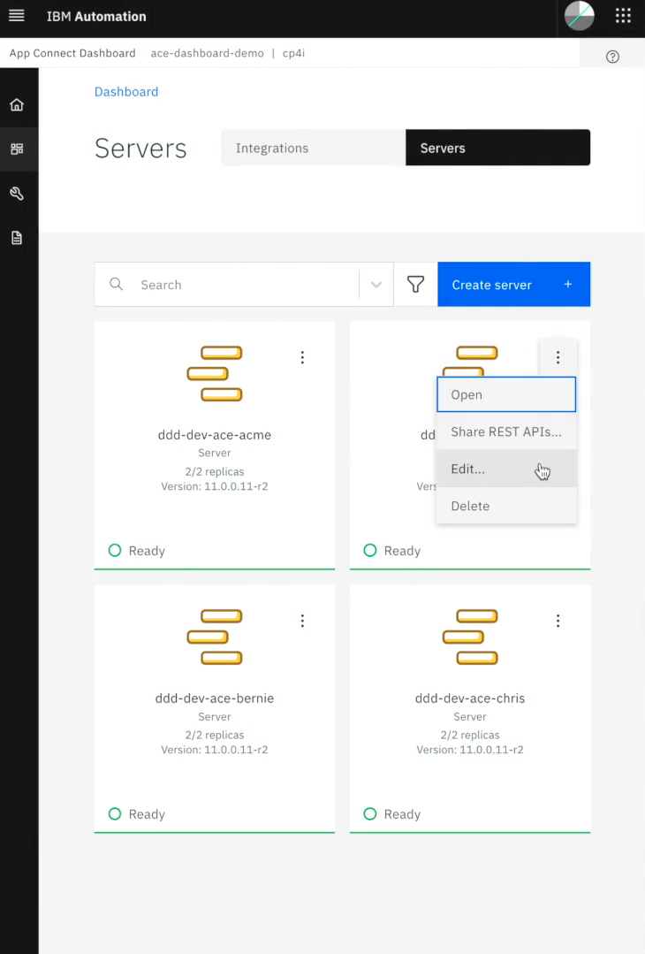
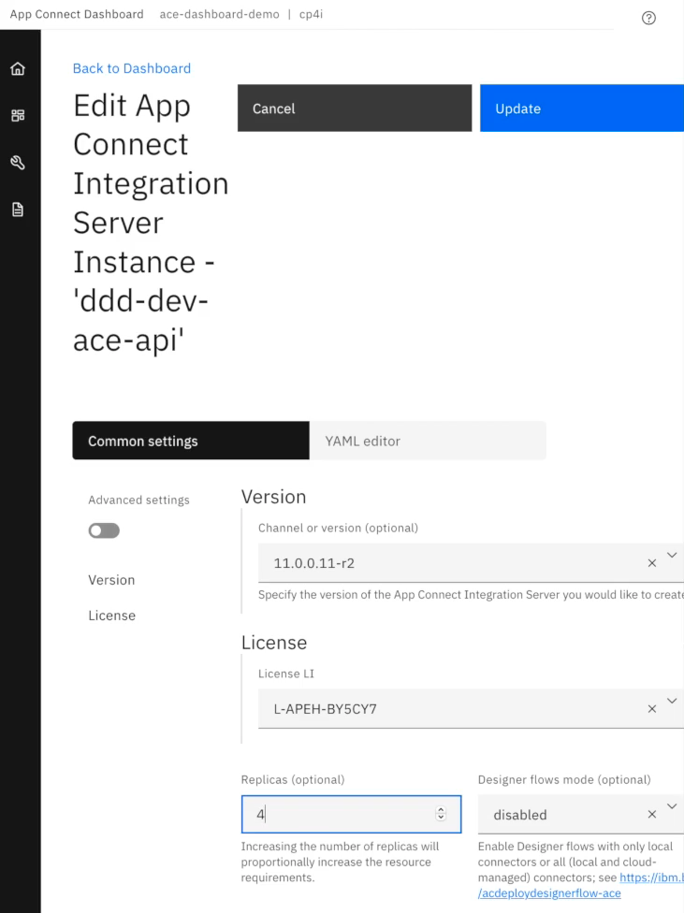

Slide 24
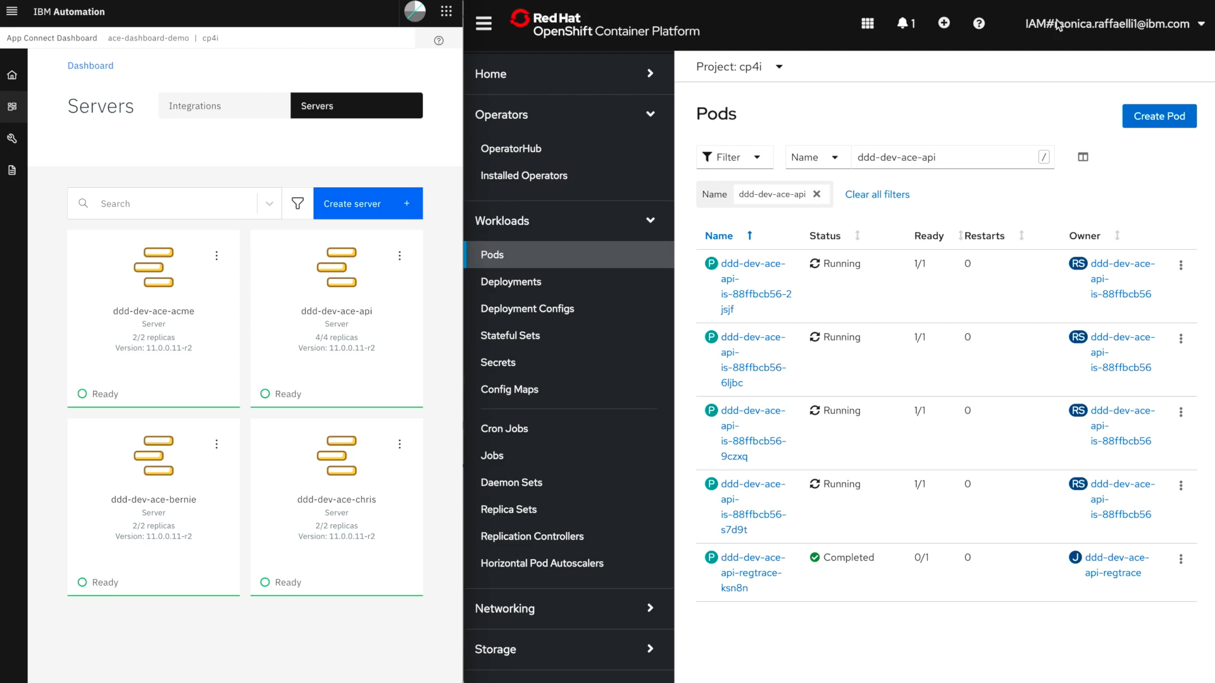

Slide 25



Traditional integration
Agile integration
People and process
Business drivers
People and process
Outcome
Centralized technology teams
Innovation
Optimization
Decentralized ownership
Empowering teams
Agile methods
DevOps/DevSecOps
CI/CD
Development agility
Architecture
Architecture
Outcome
Centralized ESB
Fine-grained deployment
API led
Event-driven
Microservices aligned
Deployment agility
Key themes
Automation
Closed loop
Multi style
Technology
Technology
Outcome
Nurtured environments
Cloud-native infrastructure
Multi-style integration capabilities
Unified security, governance and operations
Operational agility
http://ibm.biz/agile-integration
© 2021 IBM Corporation

Slide 26
Thank you

